Slide 1
Building an observation and modelling framework to explore the eco-hydro-climatology in the montane forest of Taiwan
J-Y Juang, M-H Lo

Slide 2
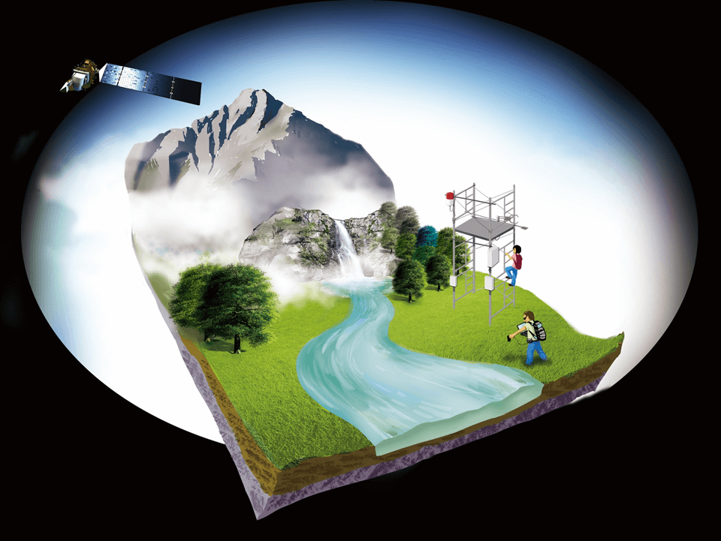
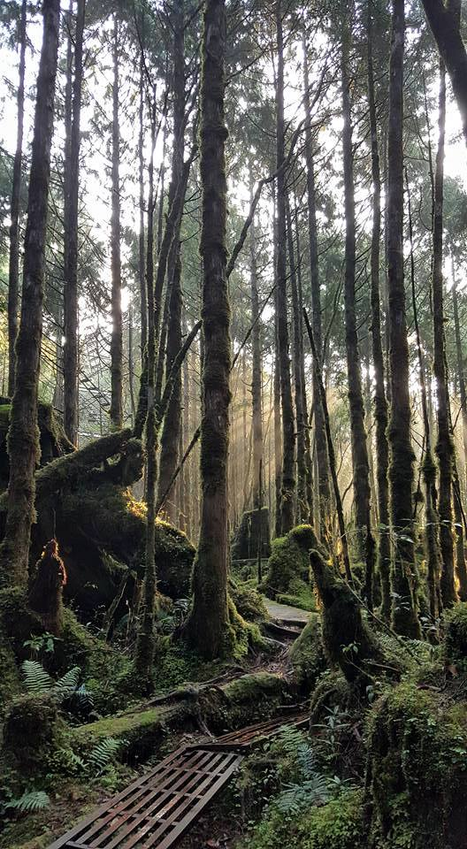
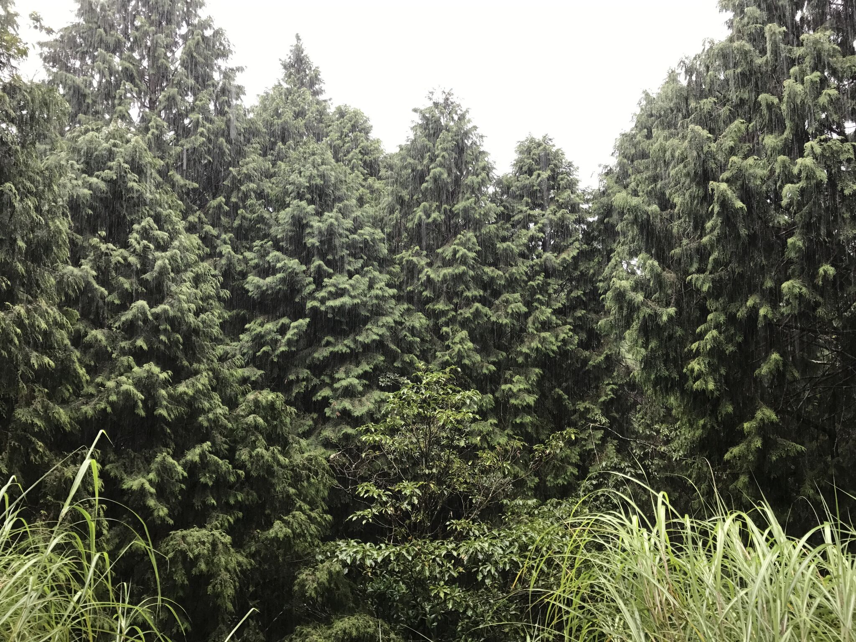
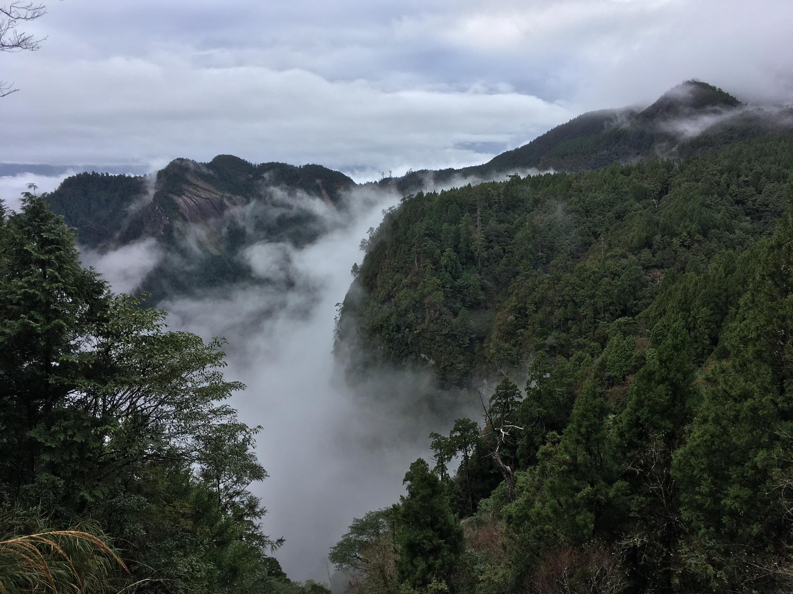
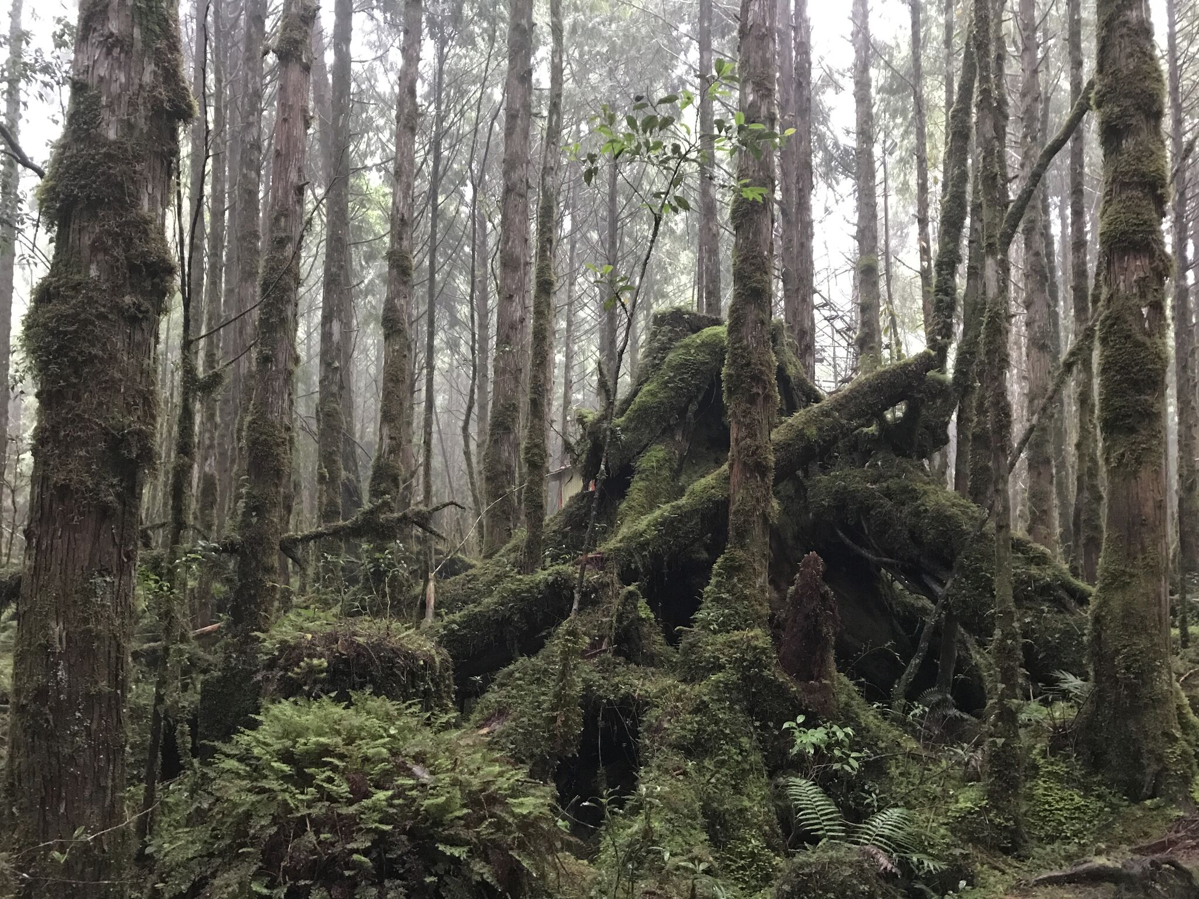
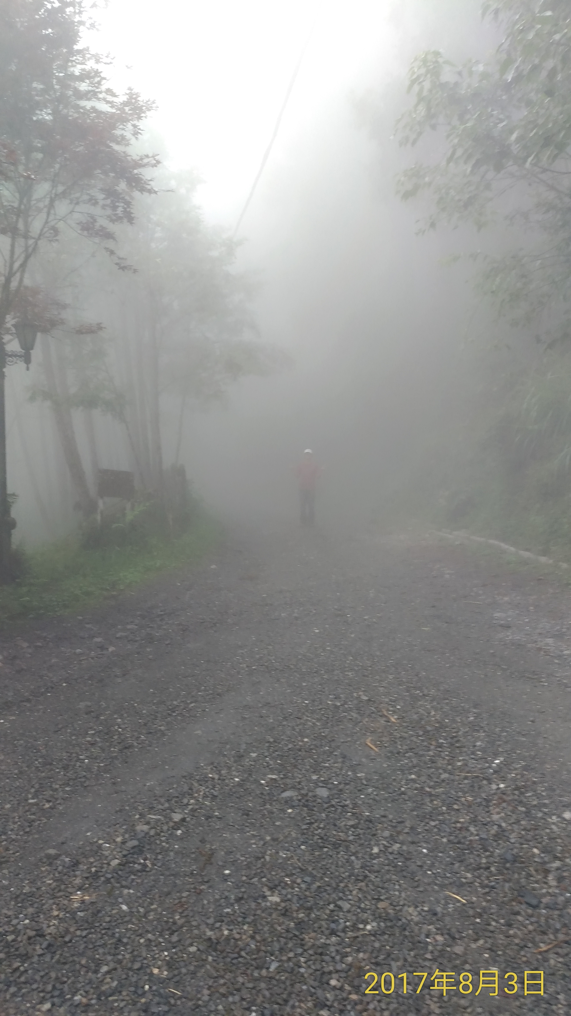
Chi-Lan Mountain

Slide 3
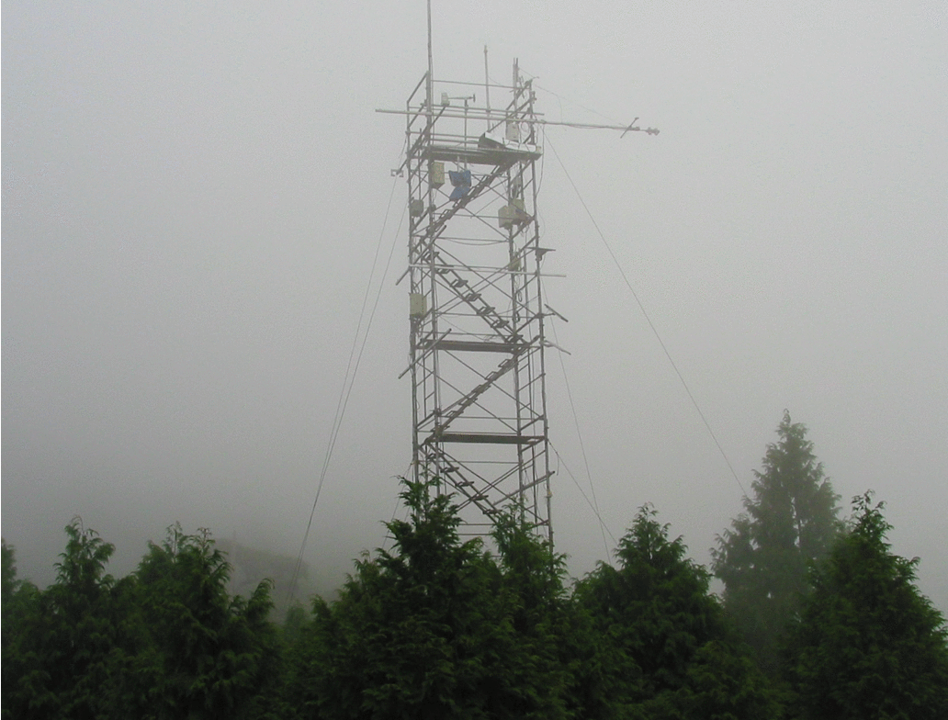

Slide 5
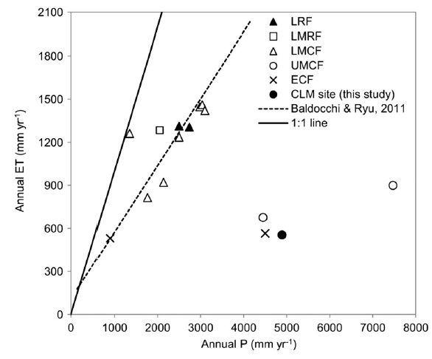
Introduction
In Taiwan, cloud forests mainly located at mountain areas. (1000m~3000m above m.s.l.)
Low ET and high P is showed in Chi-Lan montane cloud forest.
Chi-Lan
Chi-Lan
Mapped by MODIS
(Chu et al., 2014)
(Schulz et al., 2017)

Slide 6
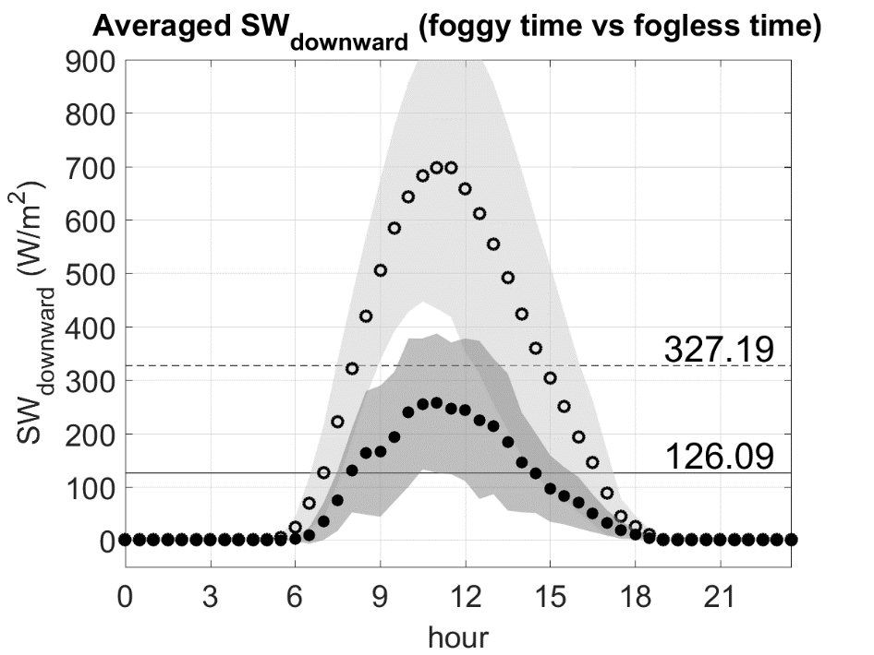
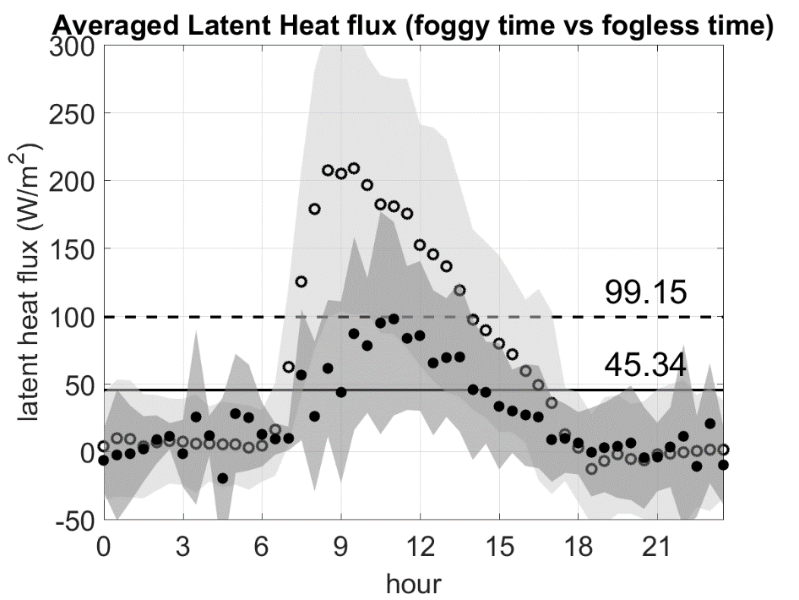
Results—the decreasing part
-54.27%
-61.46%
Fog can decrease LH flux.
High radiation correspond with asymmetric LH flux.
Guess: the trait of transpiration control afternoon LH flux

Slide 7
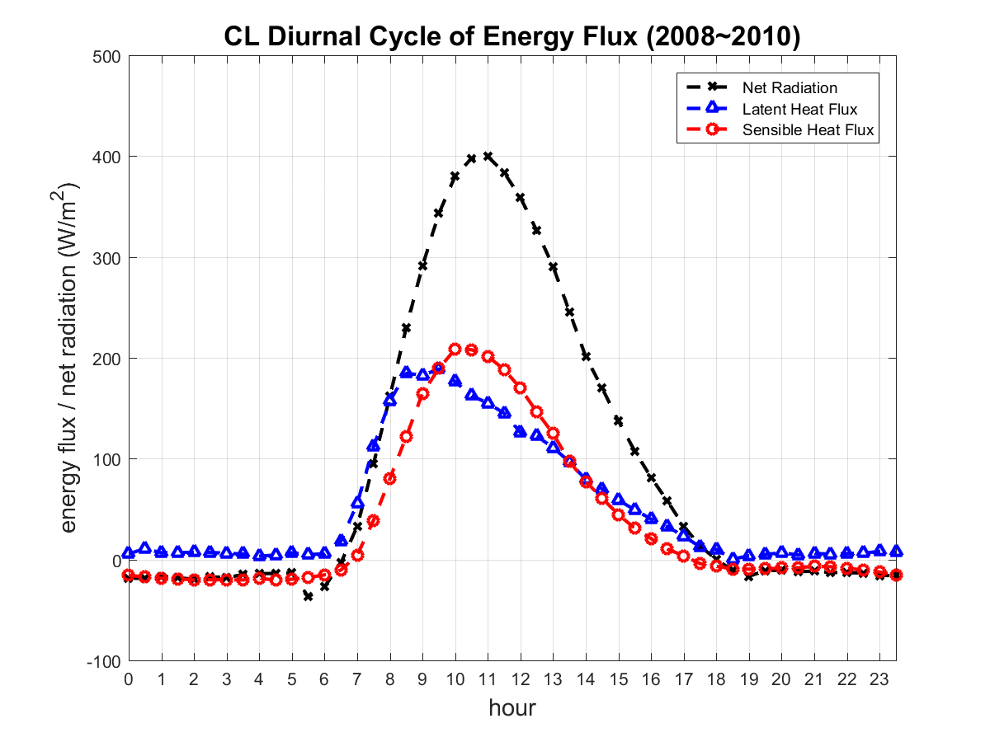
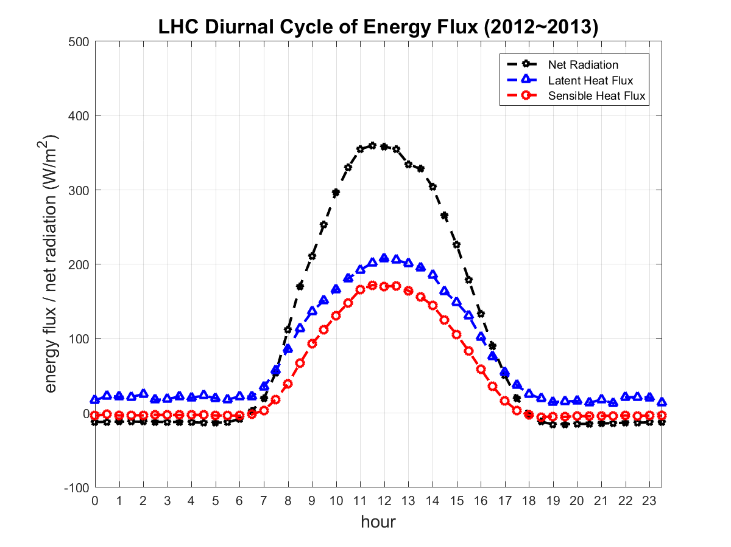
Introduction
Asymmetric latent heat (LH) flux, peak at approximately 9:00 a.m. LST
an increase in morning
a decrease after 11:00 a.m. LST
cloud forests
Not cloud forests

Slide 8
