Slide 1
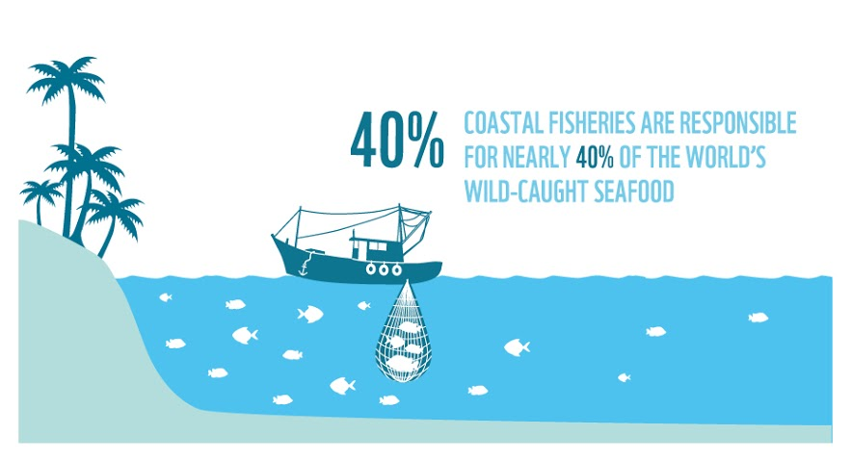
Evaluation of risk of decline for coastal fisheries species
Hui-Yu Wang & JP Chen

Slide 2
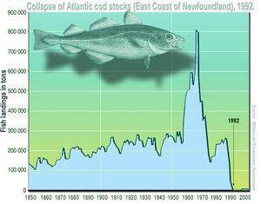
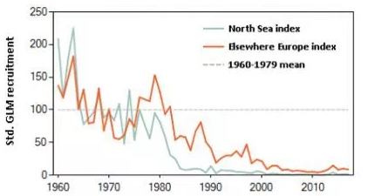
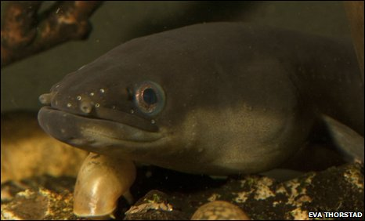
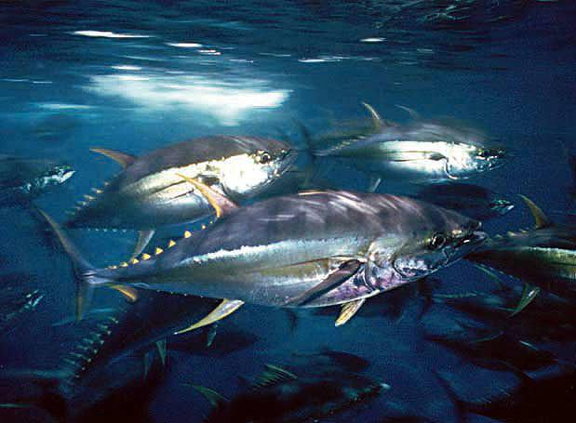
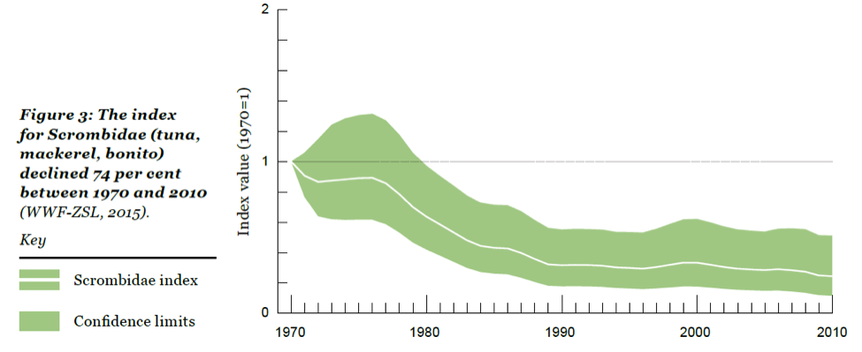
Trends in catch time series for fisheries species
Atlantic cod
European eel
https://research4committees.blog/
https://en.wikipedia.org
Squids show different trends
Tuna-like fishes
https://sustainablefisheries-uw.org/
Arkhipkin et al. 2015
Notes:
Different species display differential patterns in catch time series. Noticeably, squids show an increasing trend while others show decreasing trends.

Slide 3
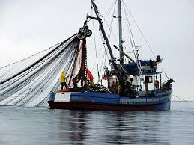
Differential population responses to fishing and climate warming
Hutchings and Kuparinen 2017
Free et al. 2019
Notes:
Recent studies found that differential population responses to fishing and climate warming; e.g., on the left hand side, for the overfished populations some recovered but some did not. On the right hand side, warming leads to increases, decreases or no changes in productivity among different species.

Slide 4
Challenge in assessing population changes
It is critical to assess differential population responses to fishing and climate change to achieve sustainable fisheries management
However, such assessment requires time- and labor-intense collection of biological data
Such assessment program is available for only a few commercially harvested species; for most other species, assessment is lacking

Slide 5
Life history traits (e.g., body size, age-at-maturity, and mortality help depict population abundance changes
Max population growth rate ($r_{max})$
x
√
√
√
Hutchings et al. 2012; Hutchings and Kuparinen 2017
Notes:
Three of these life history traits are potentially useful to depict population abundance changes (body size, age-at-maturity, and mortality). Litter size is not related to population abundance changes.

Slide 6
Example: squids vs. elasmobranch
(板鰓亞綱屬於軟骨魚綱，包括鯊魚和鰩)
Squids are short-lived with high turnover rates
→ Due to their fast life cycles, squids are less sensitive to fishing mortality
Elasmobranchs are long-lived, late mature with large body size
→ Due to its large body size and slow life cycles, elasmobranchs are more sensitive to fishing
3 squid species
3 elasmobranch species (sharks and rays)
Quetglas et al. 2016
Notes:
An example from Quetglas et al. (2016). Squids and elasmobranchs represent fast vs. slow life history types, respectively. Fast life history species with high population turnover rates are hypothesized to be less sensitive to fishing compared to slow life history species. Examining the relationship between population density and fishing intensity (in the panels below), authors found no relationships between abundance and fishing intensity for squids, but abundances decline with fishing intensity for elasmobranchs, supporting the hypothesis.

Slide 7
Investigation of population sensitivity to fishing for fish species in Taiwan
Prospective target: any unassessed exploited fish species (e.g., most reef fishes and bycatch species)
Goal: assess population sensitivity to fishing and/or environmental changes by collecting and analyzing available life history and fisheries data
Objectives:
Collect life history data of selected fishes
Collect population abundance indices (e.g., catch abundance, trade data, etc.)
Analyze population abundance changes in relation to life history traits
Notes:
Because of a lack of long-term monitoring for most species in Taiwan, there are tremendous opportunities for such assessment. For example, many reef fishes are harvested recreationally or opportunistically, but there is a lack of knowledge on their sensitivity to fisheries exploitation.

Slide 8
Suggested courses and analytic techniques
Background courses:
OCEAN 5105 Population Ecology & Sustainable Fisheries Resources
OCEAN 5052 Computer-intensive Statistics in Ecology
Analytic techniques
Programming (such as R or Matlab)
Thank you

