Slide 1
Austronesian migration in ancient time by using current climate & paleoclimatology data
Marshell lagoon (2009, Linpo)
JOINT SUPERVISOR: PO-HSIUNG LIN , ABBY REN

Slide 2
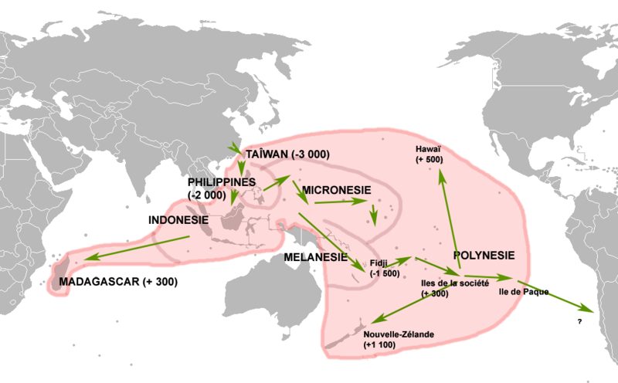
Spatial distribution of austronesian languages
3000 BC ~ 1000 AD
http://en.wikipedia.org/wiki/File:Migrations-autronesiennes.png

Slide 3
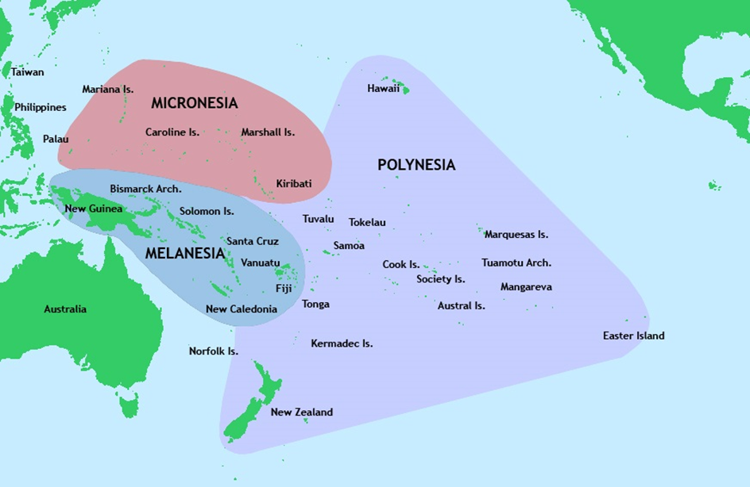
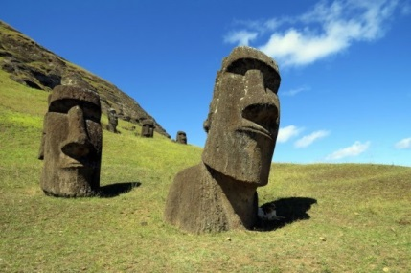
Moai

Slide 4
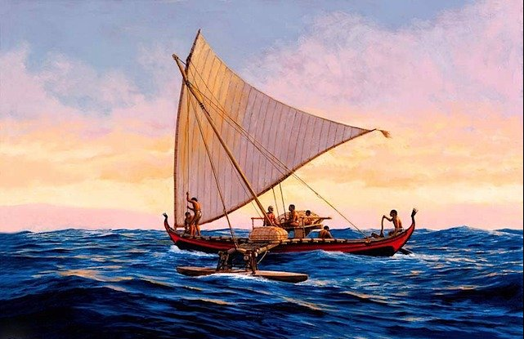
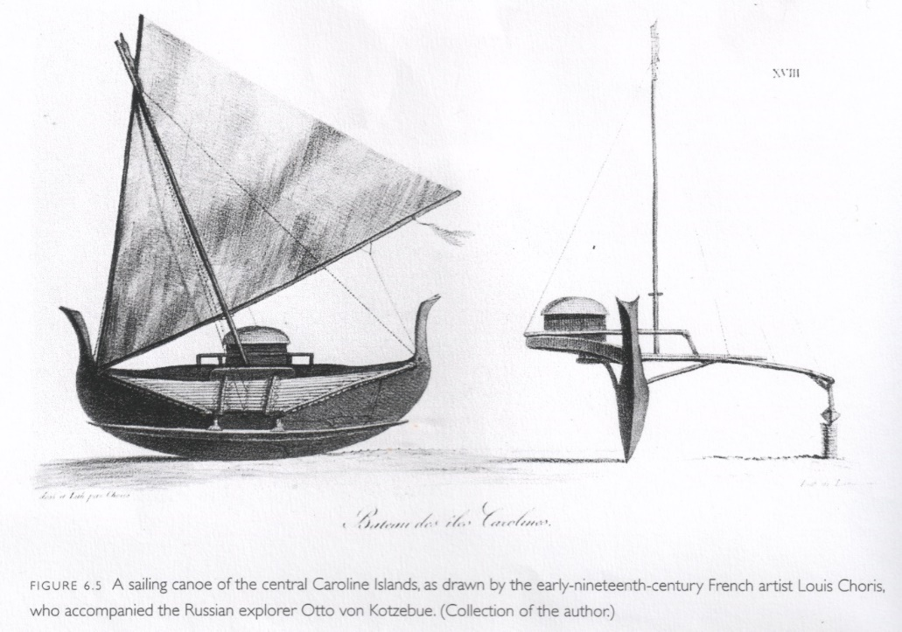
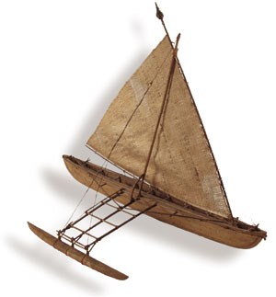
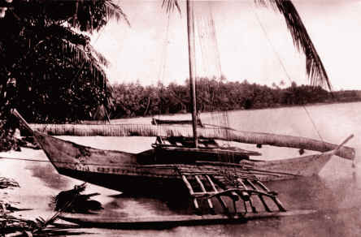
Double Canoe (WAKA)

Slide 5
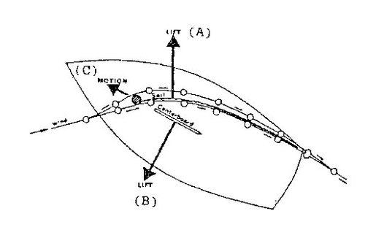
Sailing under wind
45 °
wind: fuel
Sail of boat: acceleration and deceleration (A)
rudder: steering wheel (B)
Force A, B → Force C boat movement
Dead zone

Slide 6
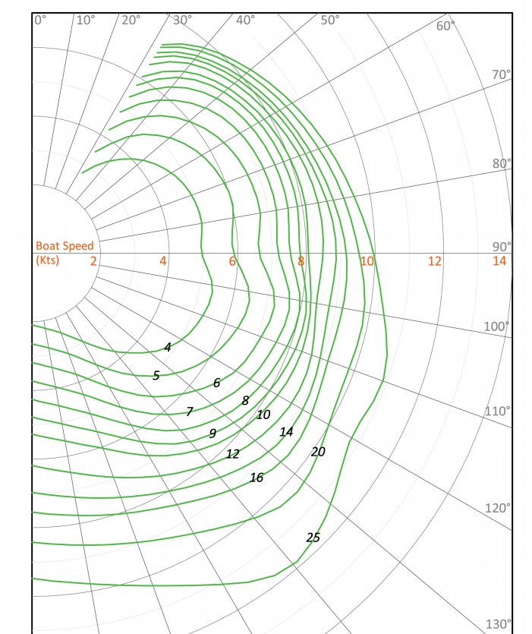
Wind direction (degree)
boat speed (Kt)
Boat movement
Wind speed (Kt)
http://www.sailnet.com/forums/boat-review-purchase-forum/62341-interesting-sailboats-330.html

Slide 7
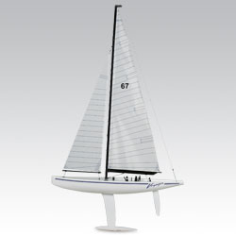
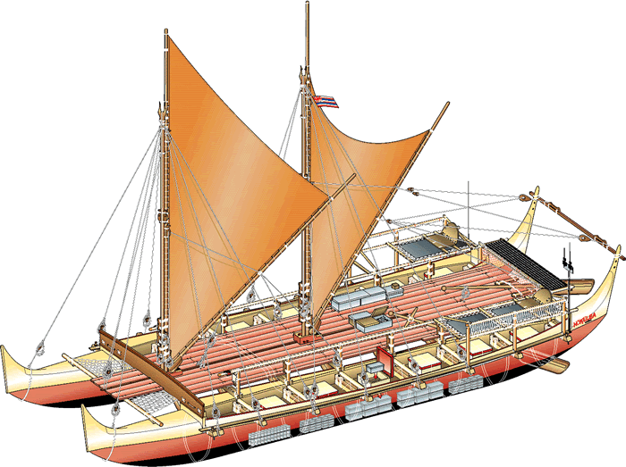
Modern sail boat
Jitdam Kapeel
Jitdam Kapeel _Canoe (Marshell island)
Nalehia
Modern
Nalehia _double desk sailboat

Slide 8
Current climate Data for model simulation
NCEP CFSR (Climate Forecast System Reanalysis)
1979/01/01 ~ 2010/12/31 (30 years)
time resolution: daily
spatial coverage/resolution:
Global, 1152*576 (~38 km/grid) for air flow
720*360 (~50 km/grid) for ocean current
Four scenarios :
(A) drift by ocean current only
(B) free sail under current and surface wind
(C) directional sail without goal
(D) directional sail with goal
Boat speed
Current speed

Slide 9
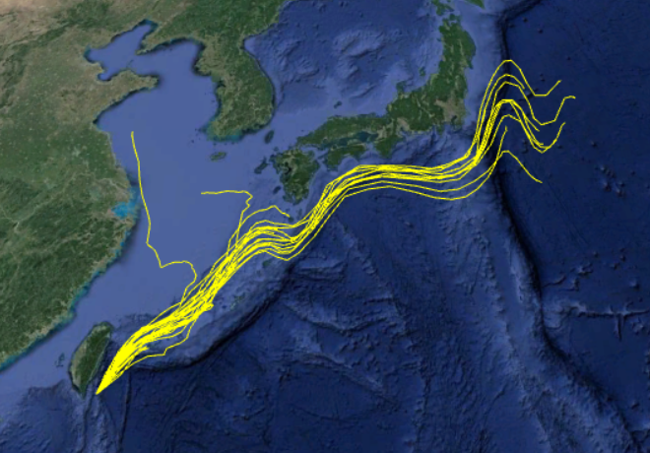
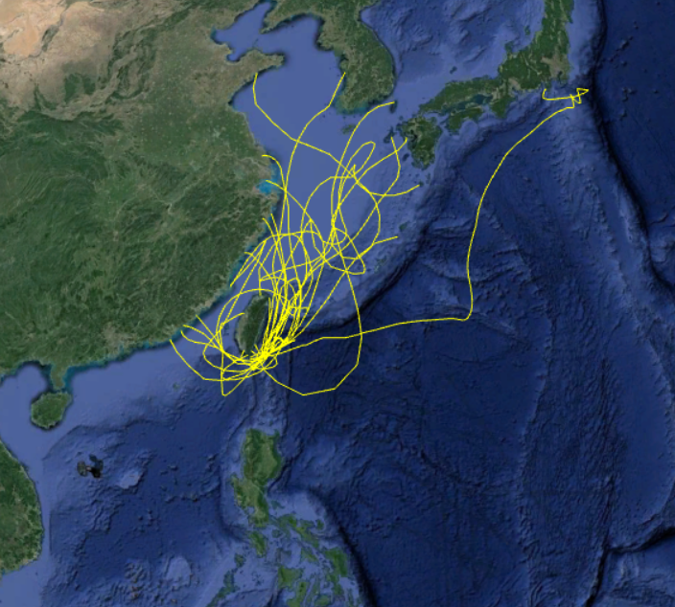
Examples:
departure from Lanyu
Every August 1, 1979 ~ 2010
Sail height:10m
Maximum days for sail: 100 days
Type:Nalehia
Scenario B
Scenario A

Slide 10
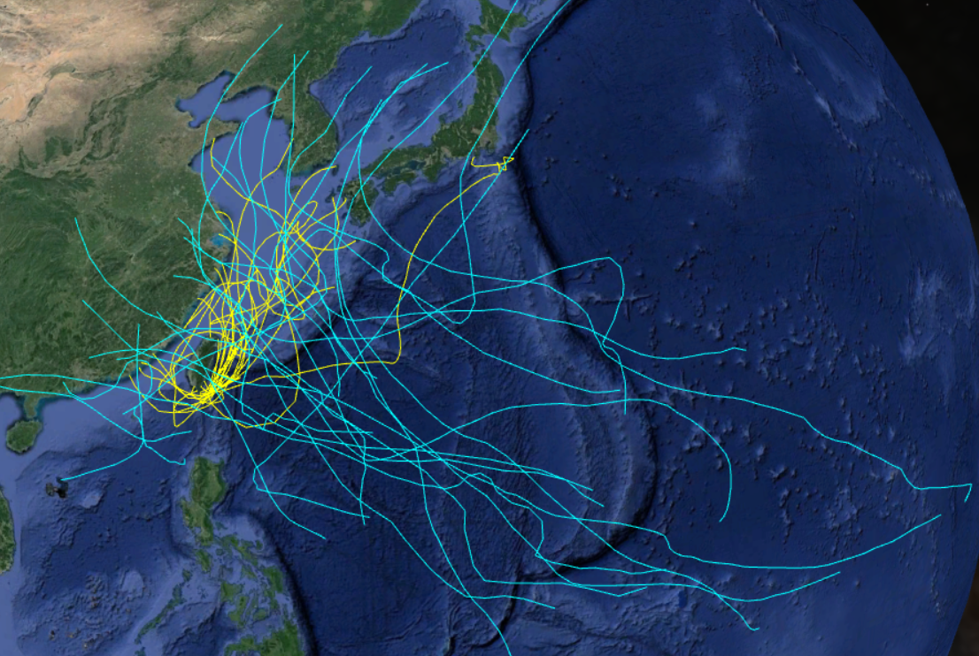
Possible impacts of tropical storms on sail track
departure from Lanyu
Every August 1, 1979 ~ 2010

Slide 11
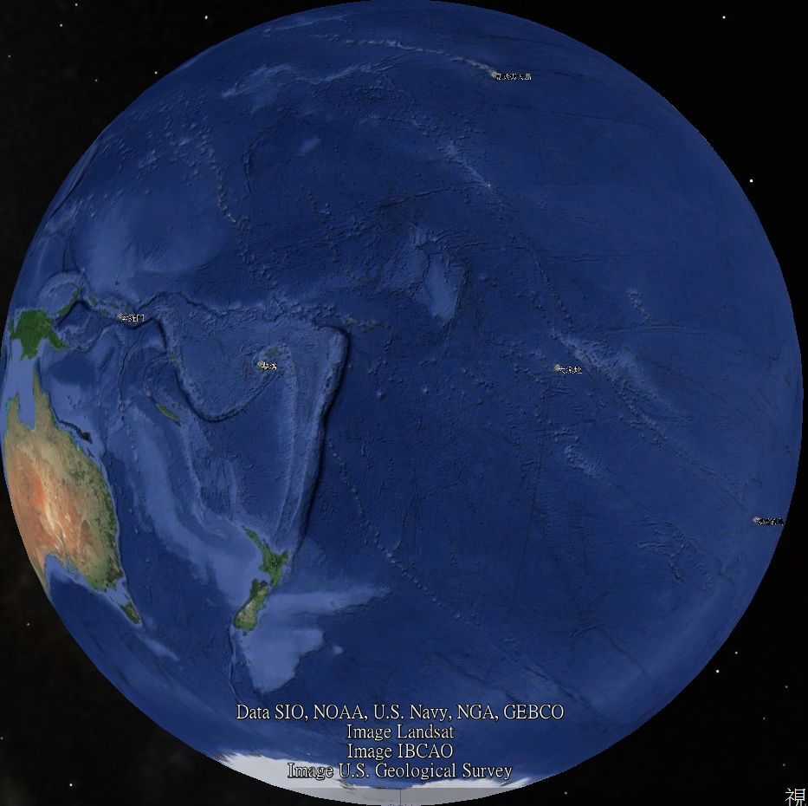
Gig Island
29.2 ± 5.2
(67,21)
Solomon islands
29.2 ± 3.4
(54,21)
Fuji
Tahiti
26.3 ± 4.7 (99,15)
36.2 ± 3.4
(56,26)
32.2 ± 4.2
(59,20)
Easter Island
New Zealand
Sailing days among pacific remote islands
(mean ± deviation) under Scenario D (modern sailboat)

Slide 12
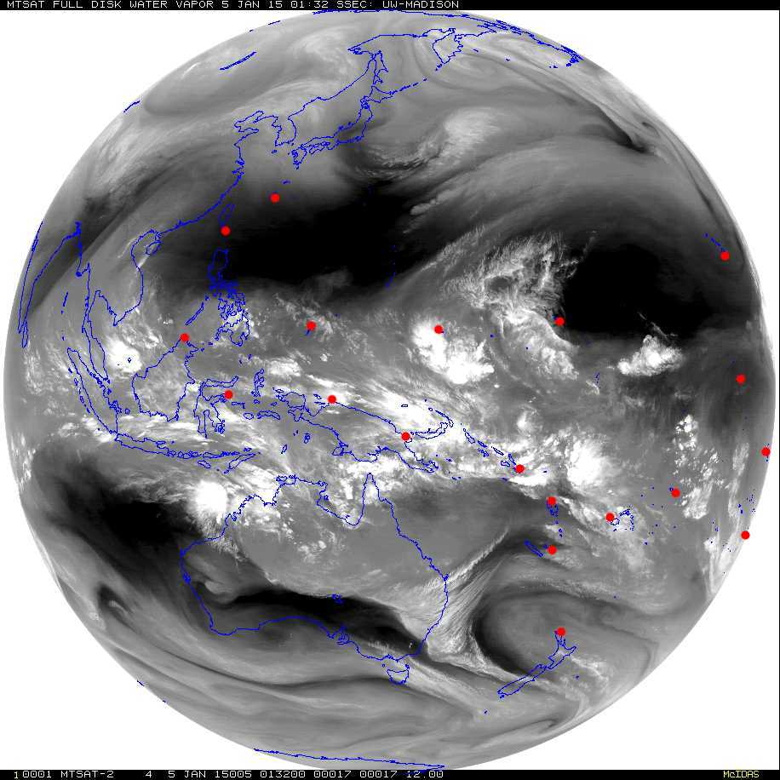
Tropical cloud system (rain, fresh water supply for sail) \
2015/01/15 01:32Z

Slide 13
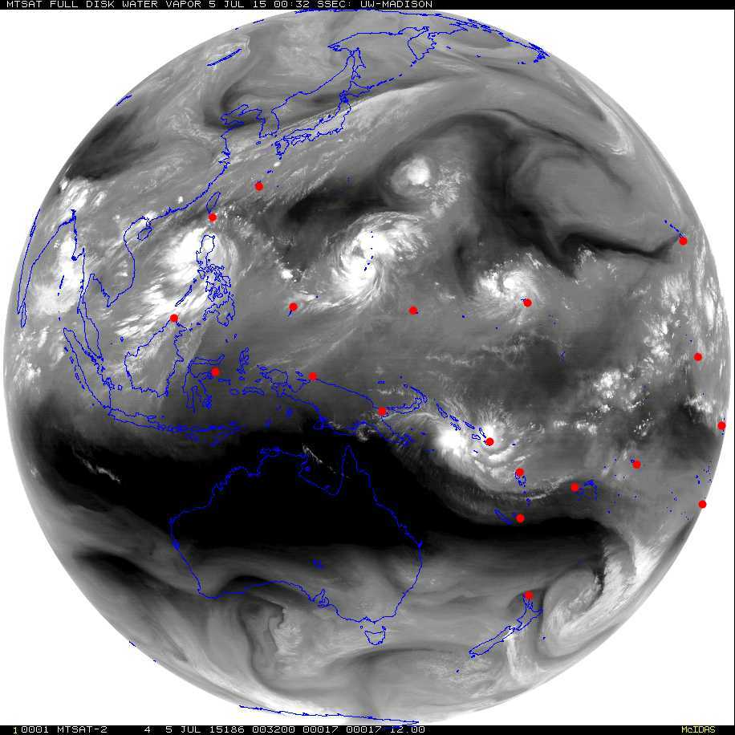
Tropical storms risk for sail
2015/07/15 00:32Z

