Slide 1
Forensic and environmental application of XRF scanning: a citizen science project
Huang et al. (2019, Scientific Reports)

Slide 2
The sampling equipment is simple and cheap!
Huang et al. (2019, Scientific Reports)

Slide 3
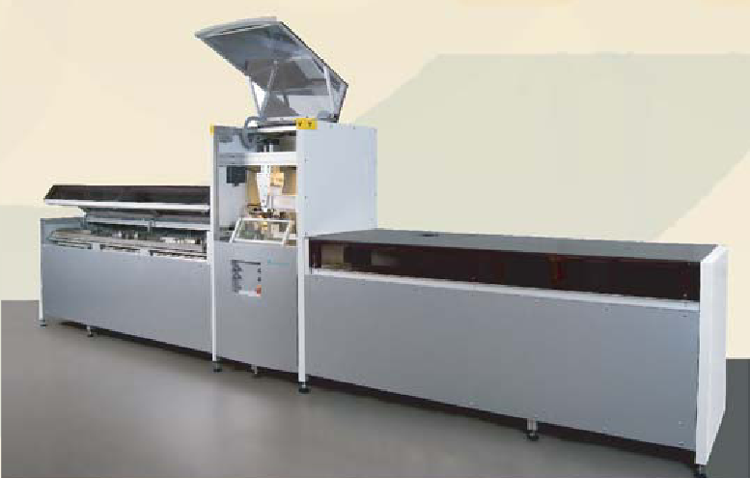
The ITRAX XRF-scanner

Slide 4

X-ray fluorescence scanning
Fe
K
Ti
Rb
Counts
Energy

Slide 5
Huang et al. (2019, Scientific Reports)

Slide 6
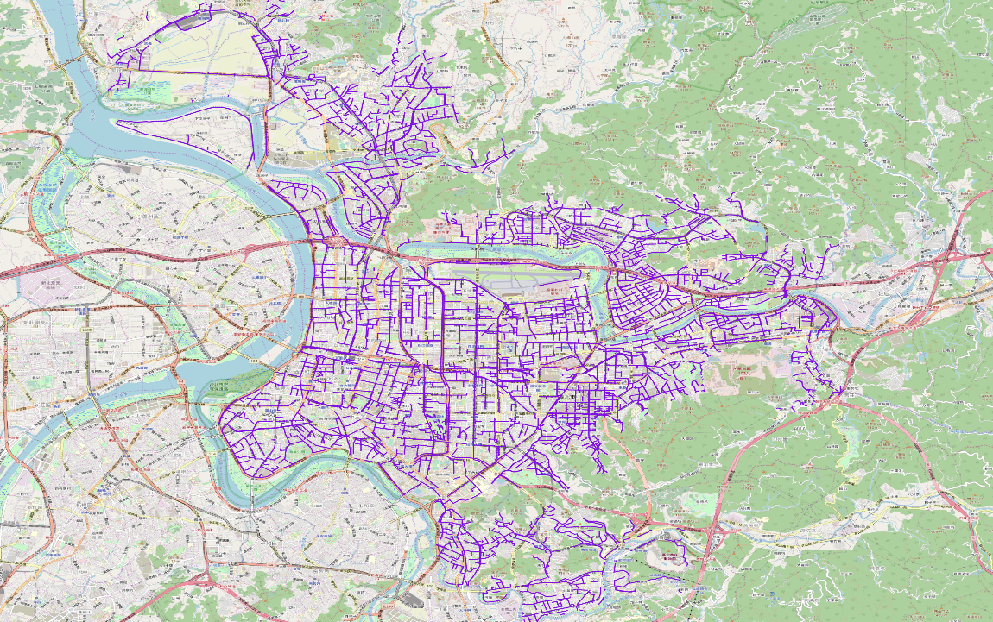
Network of underground storm drain (purple) in Taipei City
Wong (2019, MSc-thesis)

Slide 7
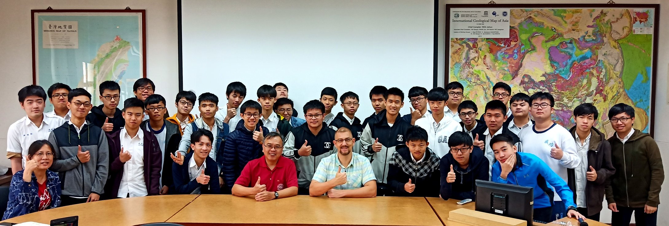
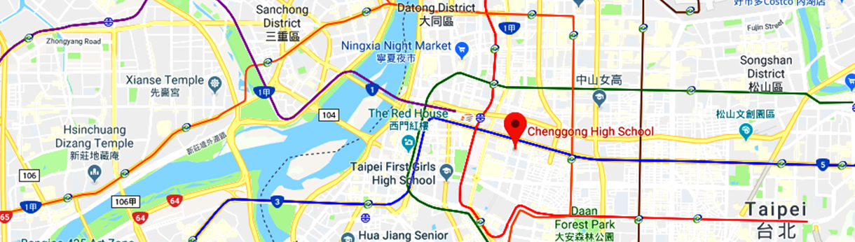
A citizen science project?
Cheng-Gung Senior High-School
>30 students eager to deploy sampling devices all over Taipei!

Slide 9
Scanning of discrete samples

Slide 10
Huang et al. (2019, Scientific Reports)

