Slide 1
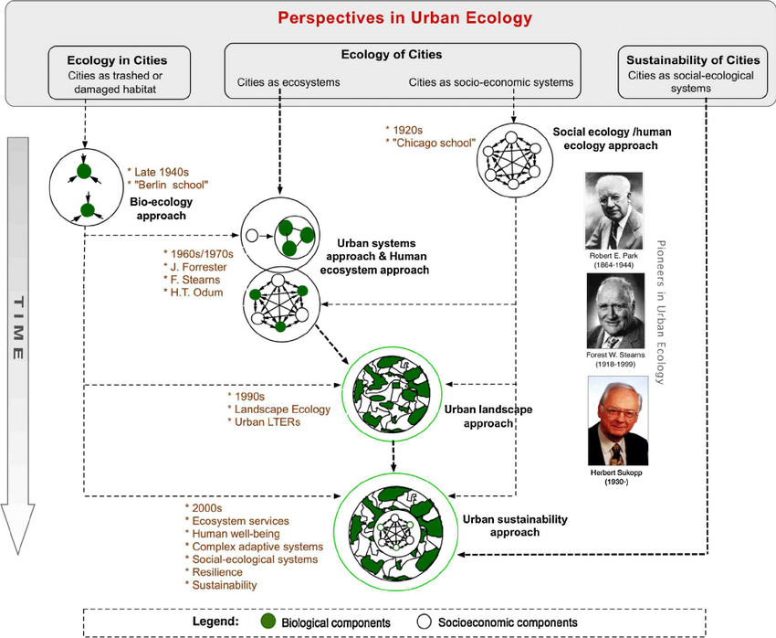
(Jianguo Wu, 2014)

Slide 2
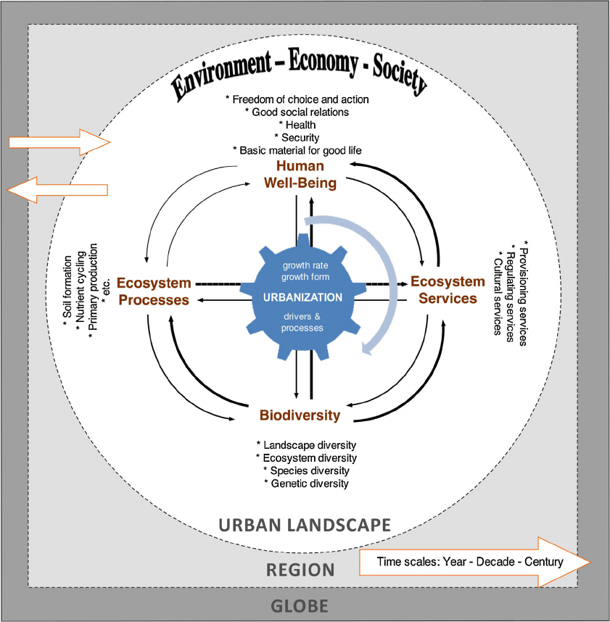
A conceptual diagram illustrating the relationships among biodiversity, ecosystem processes (or ecosystem functions), ecosystem services, and human well-being in an urban landscape.
(Jianguo Wu, 2014)

Slide 3
Ecology in, of, for cities
Pickett, S. T. A., M. L. Cadenasso, D. L. Childers, M. J. McDonnell, and W. Zhou. 2016. Evolution and future of urban ecological science: ecology in, of, and for the city. Ecosystem Health and Sustainability 2(7):e01229. doi:10.1002/ehs2.1229

Slide 4
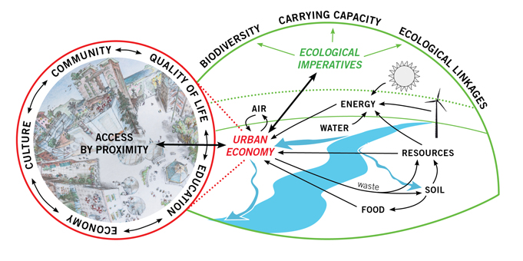
Urban Eco-System seen through the 15 dimensions of the IEFS
都市生態 Cities are urban ecosystems.
Like natural ecosystems, they bring in energy and materials and process them through their components as they flow through the system.
Urban ecosystems include concentrations of people and the built environment as well as the productive ecosystems generating the energy and matter required to sustain the whole.
Only if the urban system is ecologically complete does it have a chance of becoming self-reliant and sustainable.
http://www.ecocitystandards.org/ecocity/systems-urban-ecology/

Slide 5
Urban Long-Term Ecological Research
CAP LTER： The Central Arizona–Phoenix LTER
How do the services provided by dynamic urban ecosystems and their infrastructure affect human outcomes and behavior, and how do human actions affect patterns of urban ecosystem structure and function and, ultimately, urban sustainability and resilience?
BES：The Baltimore Ecosystem Study

Slide 6
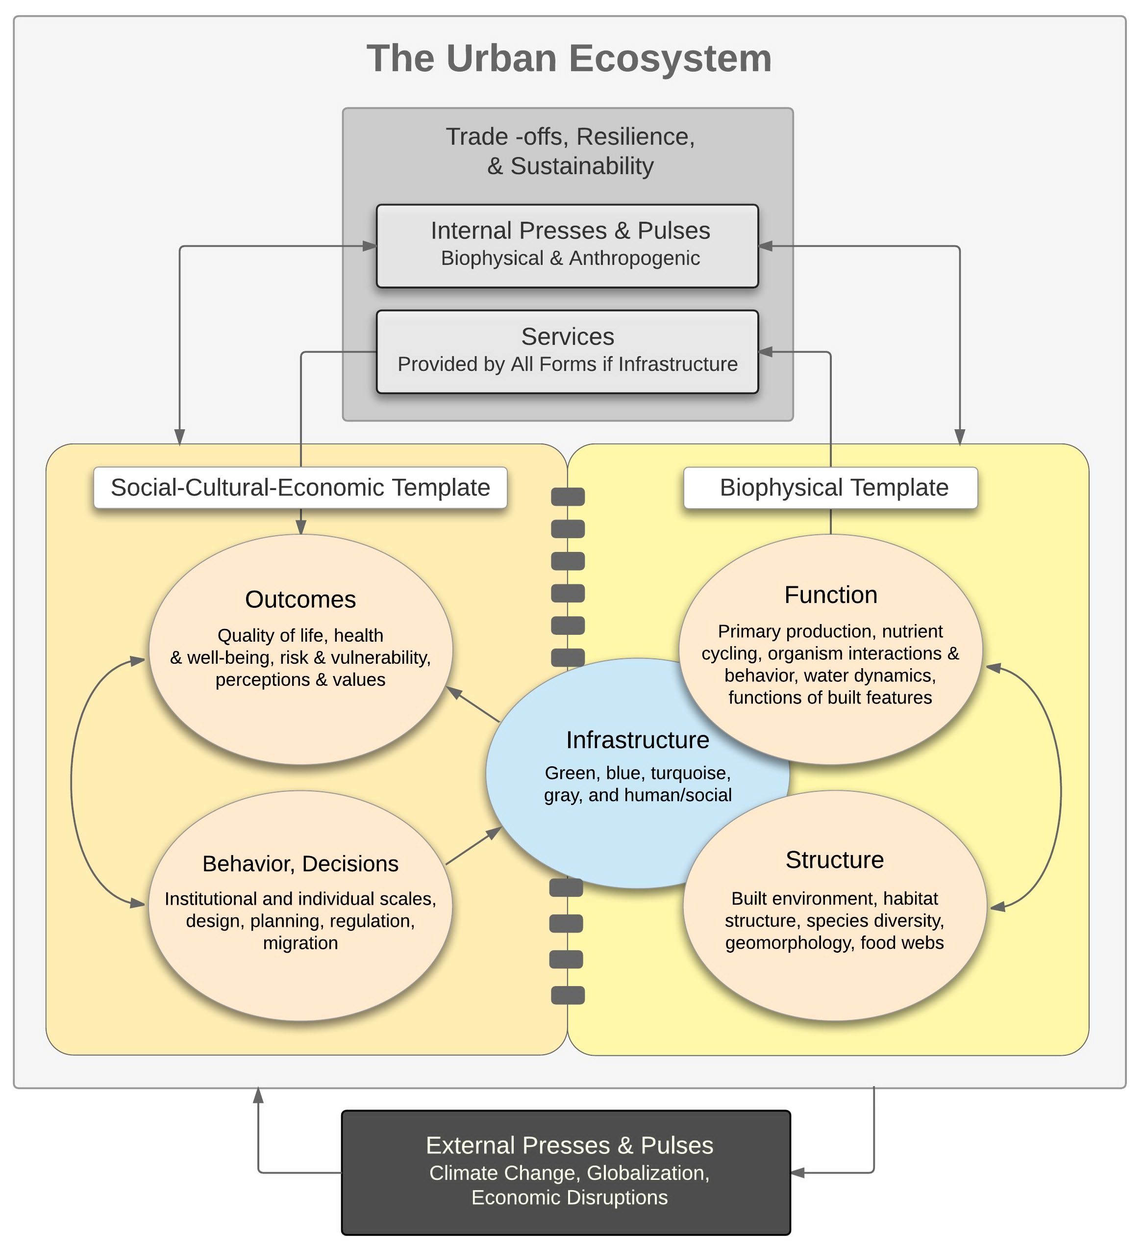
Urban LTER

Slide 7
the Baltimore Ecosystem Study (BES) Human Ecological System (HES) Long-Term Social-Ecological Research (LTSER)

Slide 8
The original guiding questions for the Baltimore Ecosystem Study (BES) are
How is the system I am interested in put together and how does it change through time?
How does the system interact with and influence matter and energy flows?
What difference does this knowledge make?
These questions have served us well over the first two phases of the Baltimore Ecosystem Study (1997-2010).
So why are we adopting a new guiding question for the third phase of BES? Why change a good thing? In fact, shouldn't a long-term study keep doing the same thing?

Slide 9
The main question for BES III is "How do biogeophysical and social adaptive processes influence and respond to policies aimed at enhancing sustainability in the Baltimore region?"
Climate change
Adaptive processes
Focusing on sustainability plans, policies, and actions suggests three, more specific research areas:
1) How do adaptive processes change as the metropolis as a whole or different segments within it evolve from a sanitary city approach to a sustainable city approach?
2) What scenarios do current and alternative policies aimed at sustainability suggest?
3) How can information exchange and education improve adaptive processes?

Slide 10
Press–pulse dynamics framework (PPD)

Slide 11
PPD six strategic research questions
How do long-term press disturbances and short-term pulse disturbances interact to alter ecosystem structure and function (H1)?
長期的壓力干擾和短期衝擊干擾如何相互作用來改變生態系統的結構和功能 (H1)？
How can biotic structure, including built structure, be both a cause and consequence of ecological fluxes of energy and matter (H2)?
生物結構, 包括建築結構, 是能量和物質生態通量的起因和結果 (H2)？
How do altered ecosystem dynamics affect ecosystem services (H3)?
變化的生態系統動態如何影響生態系統服務 (H3)？
How do changes in vital ecosystem services alter human outcomes (H4)?
重要生態系統服務的變化如何改變人類的結果 (H4)？
How do changes in human perceptions and outcomes affect human behaviours and institutions (H5)?
人類觀念和結果的變化如何影響人類行為和制度 (H5)？
Which human actions in fl uence the frequency, magnitude or form of press and pulse disturbance regimes across ecosystems and what determines these actions (H6)?
哪些人類行動在干擾系統的頻率、大小或形式的壓力和衝擊擾動制度和什麼決定這些行動 (H6)？

Slide 12
巴爾的摩生態系研究第三階段(BES III)
2011年始，進入第三階段，主要議題為「生物物理和社會適應性過程如何影響和反應巴爾的摩地區的永續發展強化政策？」，以提出城市氣候變遷調適和永續發展的新見解。
都市生態研究必須超越社會生態概念框架，採用社會-生態-技術系統(social–ecological–technical systems, SETS)架構
在巴爾的摩，凡涉及綠化、路邊排水坑道安裝、衛生污水管道改善、街道清掃頻度的增加、空地植栽種植等計畫須融合許多學科和單位的觀點。將將生態學家、永續發展城市辦公室、公共工程部、交通工程師、社區活動家，以及社會環境相關非政府組織的努力結合起來，以改善雨水管理，減輕城市熱島效應、減少水污染和升溫、增強社區凝聚力，提升人類福祉。

Slide 13
The main question for BES III
"How do biogeophysical and social adaptive processes influence and respond to policies aimed at enhancing sustainability in the Baltimore region?"
Climate change
Adaptive processes
Focusing on sustainability plans, policies, and actions suggests three, more specific research areas:
1) 自我調整過程如何改變, 作為一個整體或不同的部分, 從一個大型城市的方式演變為永續的城市方法？
2) 針對永續性的現行和替代政策提出了哪些設想？
3) 資訊交流和教育如何改進自我調整過程？

